Slide 1
Understanding
Objects
in JavaScript

Slide 2
“Everything in JavaScript is an object”
randomObject = {
property1: “hi”,
property2: “bye”,
run: function(){
console.log(“Running..”);
}
}
Well almost everything…
Objects contain key value pairs.
Objects can contain properties and methods
Objects can be accessed using dot notation

Slide 3
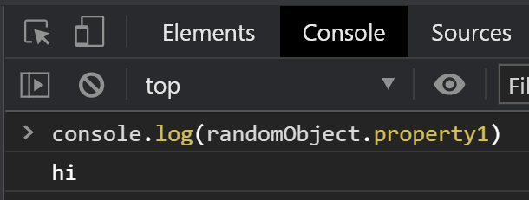
“Everything in JavaScript is an object”
randomObject = {
property1: “hi”,
property2: “bye”,
run: function(){
console.log(“Running..”);
}
}
Well almost everything…

Slide 4
So what’s with the,
“Everything in JavaScript is an object” quote?

Slide 5
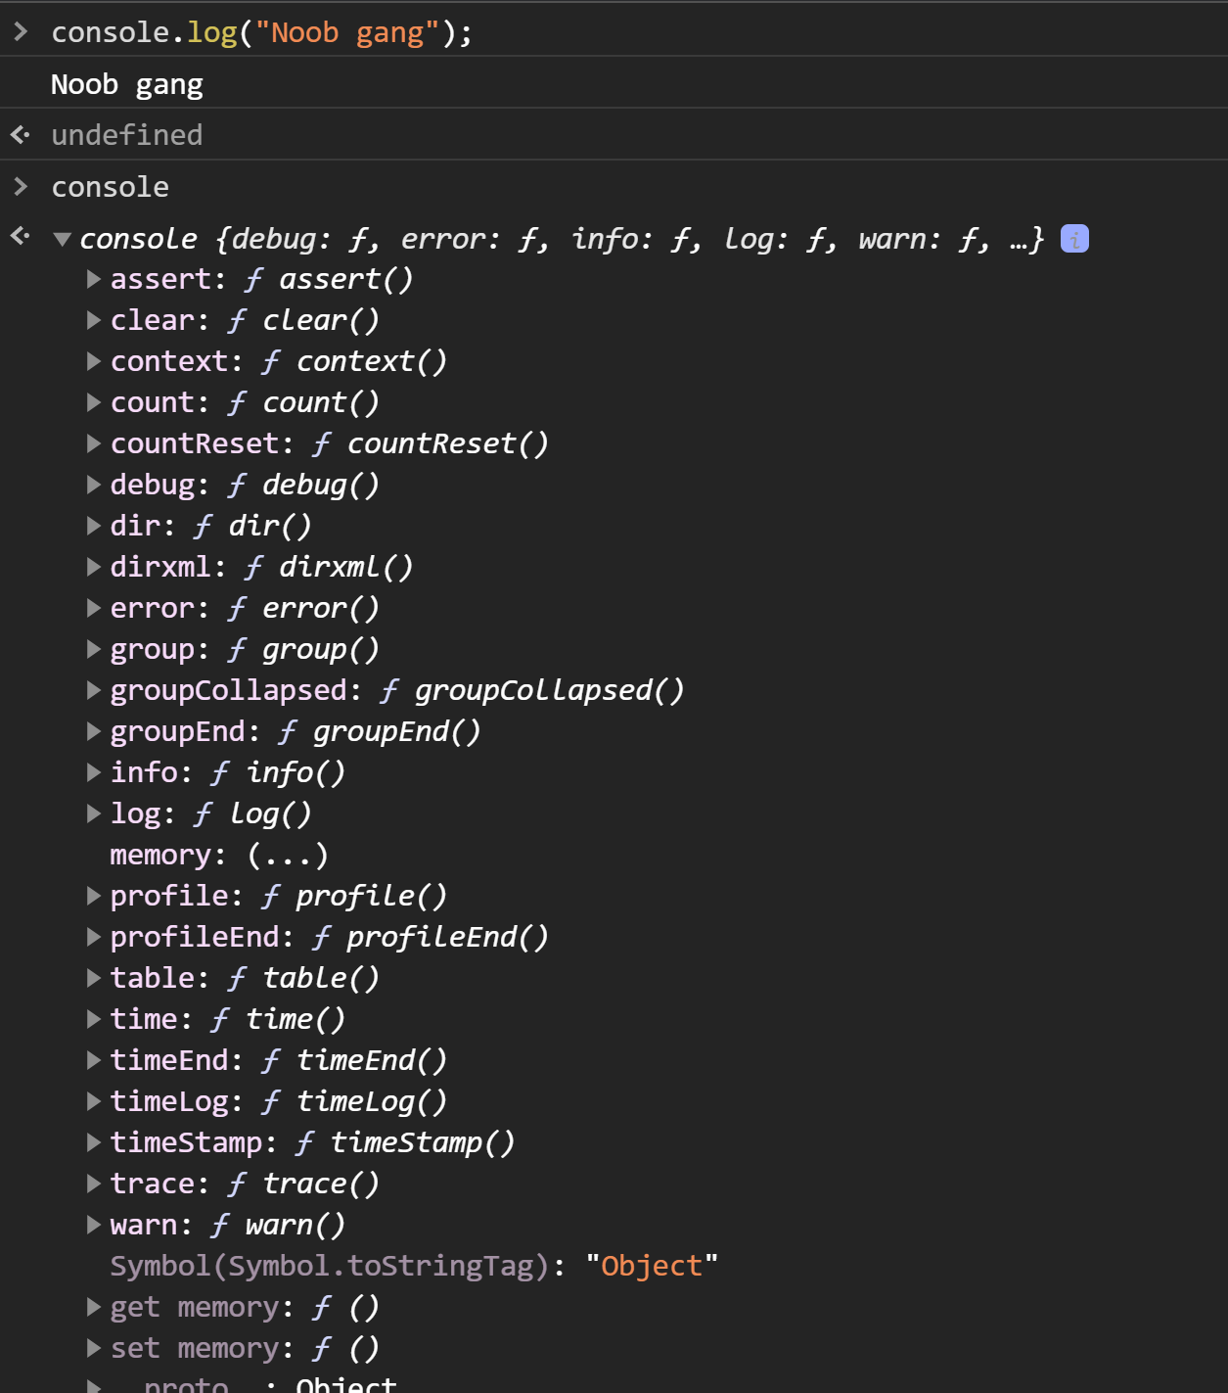
console

Slide 6
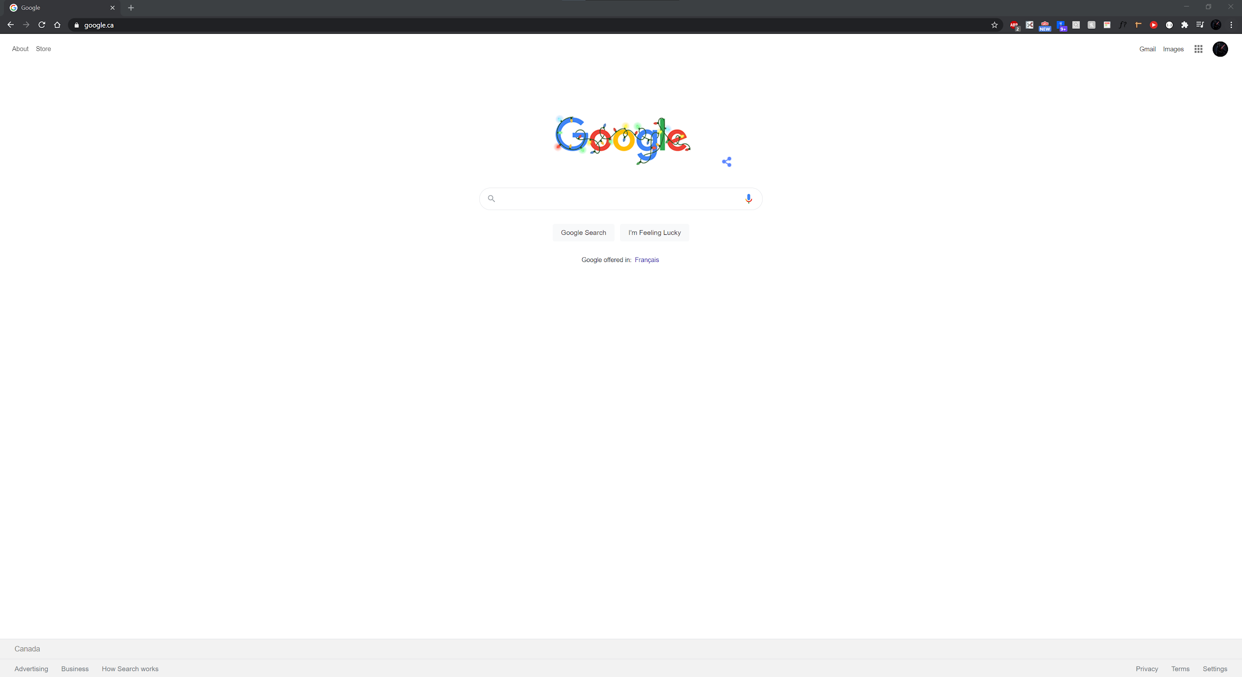
The Browser
Window

Slide 7
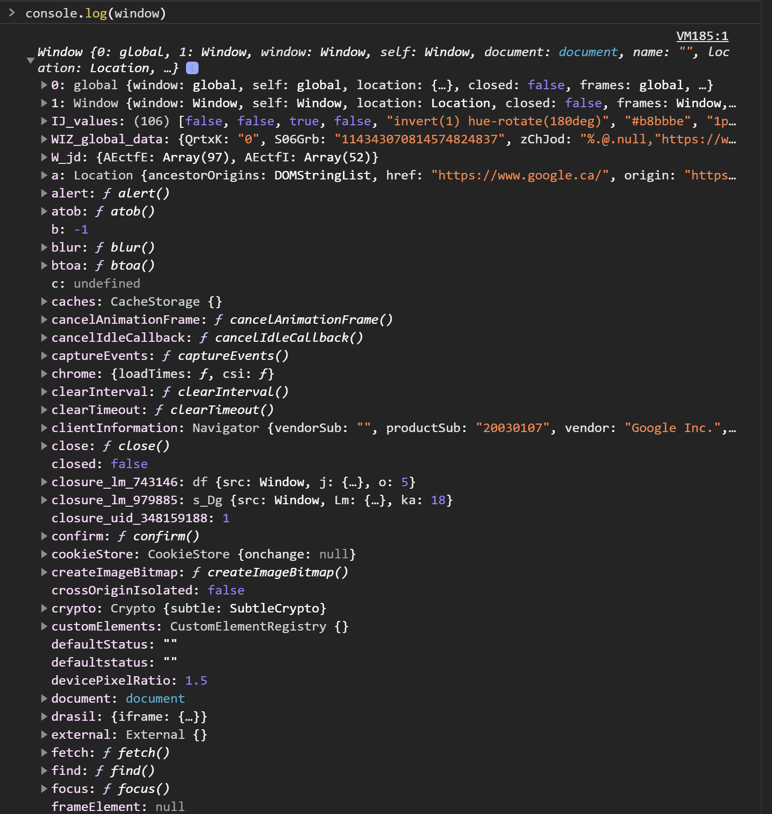
The Browser
Window

Slide 8
The Browser
Window
DOM

Slide 9
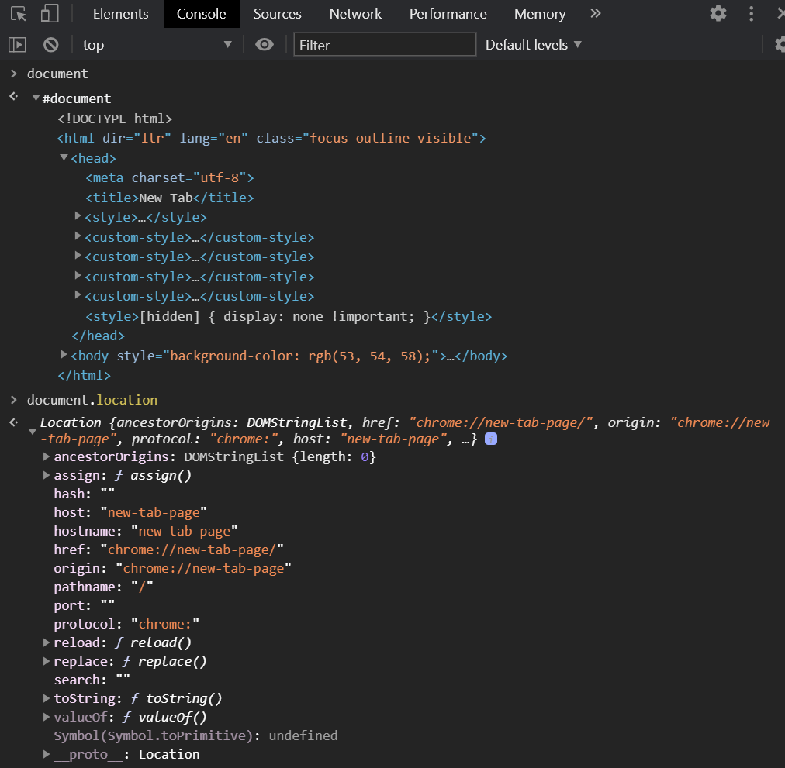
The Browser
DOM

Slide 10
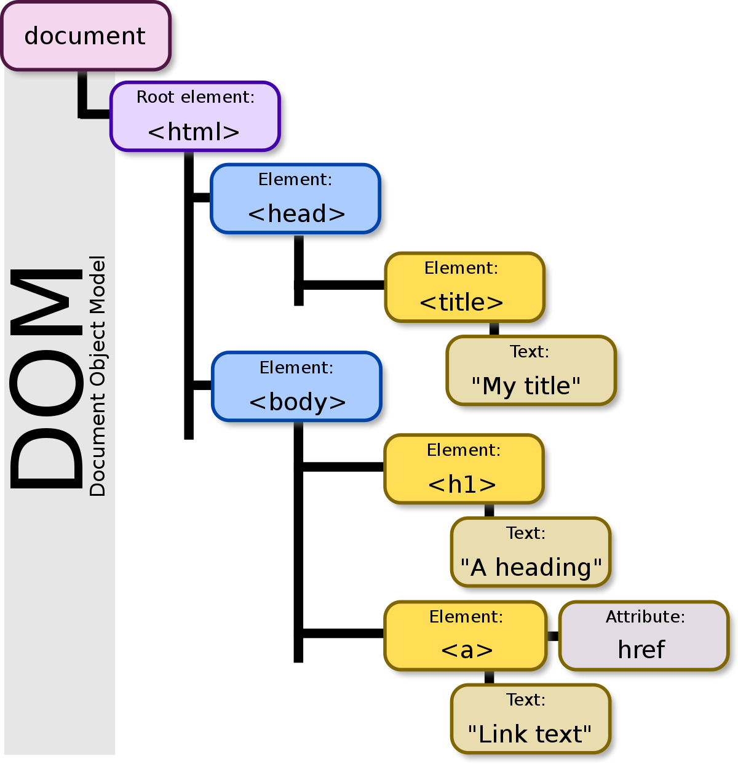
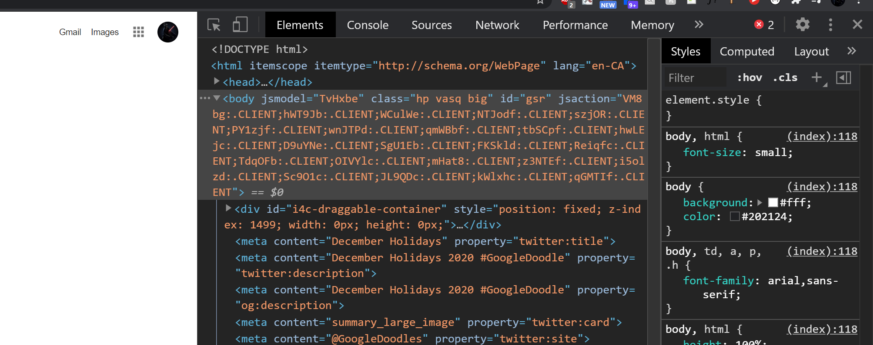
The DOM Tree
A bunch of tree nodes
Each tree node is an object
HTML turns into elements that you see on your browser
JavaScript has the ability to alter these objects (i.e. change, remove, add objects etc.)
Image taken from Wikipedia
https://en.wikipedia.org/wiki/Document_Object_Model

